Slide 1
CIS117 Week 6
Networking and user management

Slide 2

Basic networking commands
ping
Prove connection ping 10.10.10.1
Ifconfig (legacy)
Displays import info
Try it
Ip
Broader functionality then ifconfig
To display info use $ip a
Try this!
http://www.urgenthomework.com/blog/65-tips-to-be-successful-in-business-college/networking-meme/ text

Slide 3
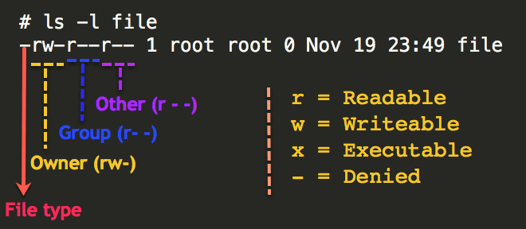
File permissions in Linux
Linux uses owner, group and public (or world)
See permissions using ls –l
Change using chmod
https://www.thegeekdiary.com/understanding-basic-file-permissions-and-ownership-in-linux/

Slide 4
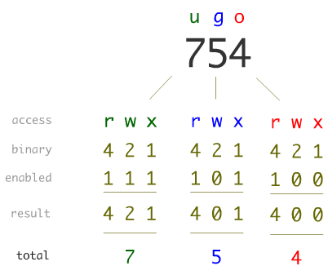
How to figure out the cool way to do permissions

Slide 5

Demo
Show ping and ifconfig
Make test file and show how to change permissions
Go through all the octal options for file permissions
https://knowyourmeme.com/photos/1170298-linux

